Slide 1
Brief Bio on Voice Recording
CHRIS TABI AMPOMNSAH

Slide 2
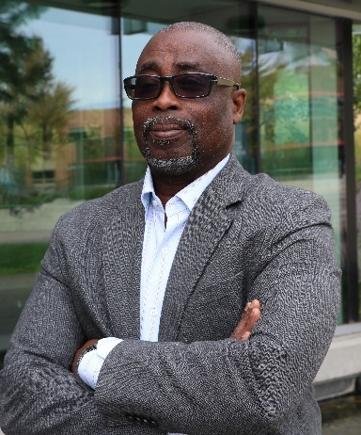
DR CHRIS TABI TRUOLFM
Dr. Christian Tabi Amponsah is Professional Engineer and Management specialist. He holds Ph.D. in Organization and Management with General Business specialization from Capella University in the United States of America. Prior to his Doctoral program, he obtained an MBA with Finance option and Civil Engineering degree from University of Leicester, UK.

Slide 3
DR CHRIS TABI TRUOLFM
A versatile Professor, Chris teaches courses in Operations and Project Management, Business Process Management, Business Negotiations, Business Ethics, Business Math, Business Statistics, Consulting Practice, Entrepreneurship, International Business, Leadership Strategy, Marketing, Management Essentials, Managing Innovation, Organizational Behavior, Project Procurement and Logistics, Purchasing and Supply Chain Management, Project Procurement and Cost Management, Research Methodology, Strategy and Strategic Management at both Bachelors and Graduate levels.

Slide 4
DR CHRIS TABI TRUOLFM
He holds memberships in the Engineers and Geoscientists of British Columbia, Academy of Management, Academy of International Business and the Project Management Institute. Currently, Chris is TRUOL Faculty and a Full Time Professor in Business Programs at Yorkville University. His foreign faculty practice spans North America, Middle East and Africa. He has published twenty-two articles in addition to have half dozen currently in print or review.
His favourate colour is blue and he like driving especially through rugged terrain.

